Slide 1
Florence County School District Three
April 2026
Board Meeting
Finance Updates
Kasey Feagin
Interim Superintendent
Hope Gibson, CSBO
Director of Finance
April 16, 2026

Slide 2
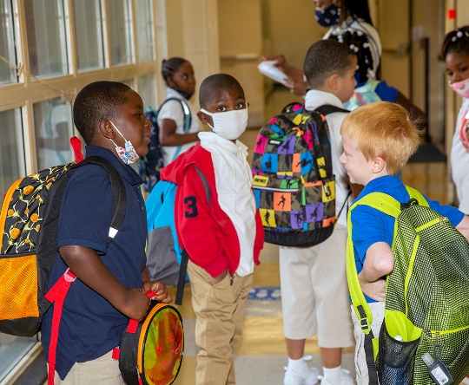
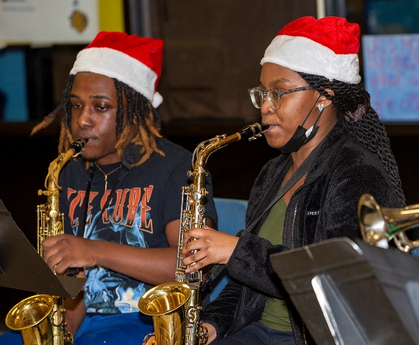
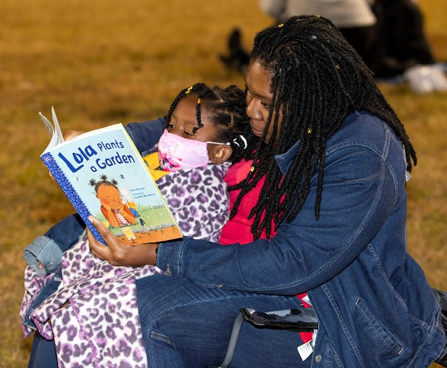

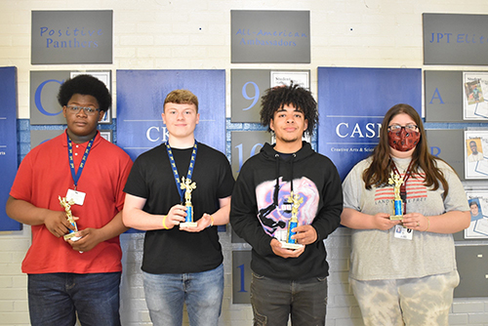
MISSION
Ensuring Our Students are College or Career Ready and are
Productive and Responsible Members of Society

Slide 3
2025-2026 DISTRICT GOALS
To improve the academic success of all students.
To ensure the safety of all district schools, offices, students, and staff.
To increase the number of students reading on grade level in grades K-3.
To recruit, retain, and train excellent instructional and administrative staff.
To build effective school, community and business relationships/partnerships.
To ensure financial stability.
3

Slide 4
MARCH 2026 Financials
GENERAL FUND REPORTS
Linked to the Board Agenda
Posted on the FSD#3 Website
GENERAL FUND APPROVED BUDGET
$35,646,811.00 FY 2025-2026
Board Approved Use of Fund Balance:
$3,000,000.00 FY 2025-2026 Stadium Upgrades
$1,200,000.00 FY 2025-2026 Purchase Service/Contract Services
$1,197,795.00 FY 2025-2026 December Bonus (Staff Bonuses) and Retention Bonus May 2026
$ 147,950.00 FY 2024-2025 Carryover-Career Modules, Network Equip., Dual Enroll., Stud. Club Field Trips
$ 7,262.00 FY 2023-2024 Carryover-Band Instr., Repairs & Supp.
$5,553,007.00
FY. 2025-2026 General Fund Approved Budget + Board Approved Use of Fund Balance
$41,199,818.00

Slide 5
General Fund Budget By Object Code

Slide 6
TIMELINE FOR 2026-2027 BUDGET APPROVAL
Thursday, March 19, 2026 1st Reading of PROPOSED Budget
Thursday, April 16, 2026 1st Public Hearing @ 5:00 pm
Thursday, May 28, 2026 2nd Reading
Monday June 01, 2026 2nd Public Hearing @ 12:00 pm
Thursday, June 18, 2026 FINAL Reading

Slide 7
General Obligation Bond Request
Board Approval Required

